Slide 1

IELTS Speaking
BY: ASAAD ALOFI

Slide 2
IELTS Speaking Section
How many parts are there in IELTS Speaking?

Slide 3
IELTS Speaking Section
The IELTS Speaking test lasts about 11 to 14 minutes. It has three parts and it’s worth is 25% of your IELTS score.

Slide 4
IELTS Speaking Part 1 Questions
The questions in IELTS Speaking part 1 are always like yes/no questions followed by Wh questions.
Do you like watching TV? - Yes, I…
What kind of movies do you watch?
Who do you watch the film with?
When do…?

Slide 5
IELTS Speaking Section
Part 1 ( Simple questions about your, family, home, life, country)
Part 2 (a card to describe someone, something, place or event)
Part 3 ( follow up questions about part 2)

Slide 6
IELTS Speaking Part 1
The 1st topic is always: Do you work or you study? Where do you live?
The 2nd & 3rd topics can be about anything general.(rain, movies, color, habits, etc)

Slide 7
IELTS Speaking Part 1
Remember that !!
The examiner doesn’t care about your answer(Yes/ No).
They want to see how you communicate.

Slide 8
2 Rules give you a high score in Part1
1st Rule: Make sure you to answer the question.
2nd Rule: (show your English ability by grammar,vocabulary,pronunciation,organization)

Slide 9
How will you be assessed in All parts?
1- Fluency & Cohesion
2-Lexical Resources (Vocabulary)
3-Grammar
4-Pronunciation

Slide 10
1- Fluency & Cohesion
-Do you speak smoothly without long pauses?
-Do you produce new information?
-Do you link your ideas by using fluency markers?
(however, as a result, unfortunately, so, for example…)
NOTE: Fluent doesn’t mean speed( not fast, not slow)

Slide 11
2-Lexical Resources (Vocabulary)
This includes :
1- Linking words (nowadays, unfortunately, etc )
2-Topic words ( topics about TV, sport, films , etc)
3-Phrasal verbs (take off, look after, look for, etc)
4- Idioms ( cost an arm and a leg) means expensive

Slide 12
List of useful idioms
1- cost an arm and a leg ( to be very expensive)
2- raining cats and dogs ( to rain heavily)
3- piece of cake or as easy as pie ( very easy)
4- once in a blue moon (very rarely)
5- kill two birds with one stone ( give two reasons for something)

Slide 13
3-Grammar
Don’t make mistakes that affect the examiner’s ability to understand you.
Pay attention to the ( Subject-Verb- Agreement)
My father have a nice car. (has)

Slide 14
4-Pronunciation
Pronunciation refers to the way of saying the words during your speech.
E.G ( world, walked, girl, etc)

Slide 15
IELTS Speaking Essentials
1- Never answer with one word.
2- Show your language ability through (grammar, vocabulary, pronunciation, organization)
( Avoid using always and never) they give inaccurate information. I always play football at the weekend.

Slide 16
Ways to impress the examiner.
1-Start answering the questions by some fillers like ( To be honest, Personally, I think, well it is not about, in fact)
2- Always paraphrase the question to sound better.
What did you like to read as a child? As a child, I like reading. When I was a kid, I love reading… because…

Slide 17
Ways to impress the examiner
3- Paraphrasing statements about favorites things/people
What is your favorite food to eat?
My favorite food is bread. ( low mark)
To be honest, the X I love most is… ( high mark)

Slide 18
Ways to impress the examiner
If the question is the opposite you will make a slight difference.
What is the least food you like to eat?
Use To be honest, the X I love least is …because…
Or To be honest, I really dislike X because…

Slide 19
Comparison Questions
Would you rather own a dog or a cat as a pet?
Do you prefer reading books or magazines?
Do you like eating fast food or traditional food?

Slide 20
Comparison Questions
If the question has ( would you rather) use
( would prefer to) or make the opposite.
e.g- I would prefer to own a cat because…☺

Slide 21
Use Adjectives
Use adjectives to describe things or people.
V+ ed is used when things or people doing the feeling (effect) like relaxed, annoyed, excited
V+ing is used for things causing the feeling (cause) like relaxing, annoying, exciting

Slide 22
The End of Part 1
Do you have any question so far?

Slide 23
IELTS Speaking Part 2
The examiner will be giving you a card, and the card will have a task on it. They want you to talk about something…

Slide 24
What do they want you to talk about?
That will be nouns:
- People
- Places
- Objects
- Events

Slide 25
How ?
You will be given the card first.
You will be given one minute to prepare (Notes)
You have to talk for two minutes
There are no questions in part 2.

Slide 26
Cue Card sample
Describe an interesting conversation you had with someone
You should say:
- who the person was
- where the conversation took place
- what you talked about
And explain why you found the conversation interesting.

Slide 27
Part 2 Tips
Introduction:
1) I am going to describe . . .
2) The X I would like to describe is . . .
3) I am going to talk about an X . . .

Slide 28
Part 2 Tips
1) the one I’d like to tell you about is… 2) my favourite was…
3) I’d like to talk about...
4) Let me tell you about…
5) Personally, I would have to say…
6) the one who/that stands out is…
7) I’m going to tell you about...

Slide 29
Part 2 Tips
1) the one I’d like to tell you about is…
Describe something you do to stay healthy.
I do many things that contribute to a healthy lifestyle but the one I’d like to tell you about is…

Slide 30
Part 2 Tips
2) my favourite was…
Describe a TV programme you have watched recently.
I have watched several good TV programmes recently but my favourite was…

Slide 31
Part 2 Tips
3) I’d like to talk about...
Describe a day out that you enjoyed.
I’d like to talk about the time I went to…

Slide 32
Part 2 Tips
4) Let me tell you about…
Describe a special friend.
Let me tell you about my friend Ahmed.

Slide 33
Part 2 Tips
5) Personally, I would have to say…
Discuss the meaning of happiness for you.
Personally, I would have to say that being happy...

Slide 34
Part 2 Tips
6) the one who/that stands out is…
Describe the best teacher you have ever had.
I’ve been lucky enough to have had several really good teachers but the one who stands out is…

Slide 35
Part 2 Tips
7) I’m going to tell you about...
Describe a photograph you particularly like.
I’m going to tell you about a photograph I took...
Then (I’ve chosen this… because…)

Slide 36
Part 2 Tips ( Super Strategy)
I am going to talk about X, It is one of the most … and … X I have ever … in my life.
I didn’t choose this particular X to talk about because it… only ,but because it also…
That’s why!!(STOP) and in order to kill two birds with one stone I… and …
Then start adding details about the topic.

Slide 37
Part 3
Follow up questions related to Part 2 topic or any relevant one.
Try to answer for 30 seconds at least.

Slide 38
6 Common questions for Part 3
1- Opinion
2- Hypothetical
3- Compare & Contrast
4- Change
5- Future
6- Benefits

Slide 39
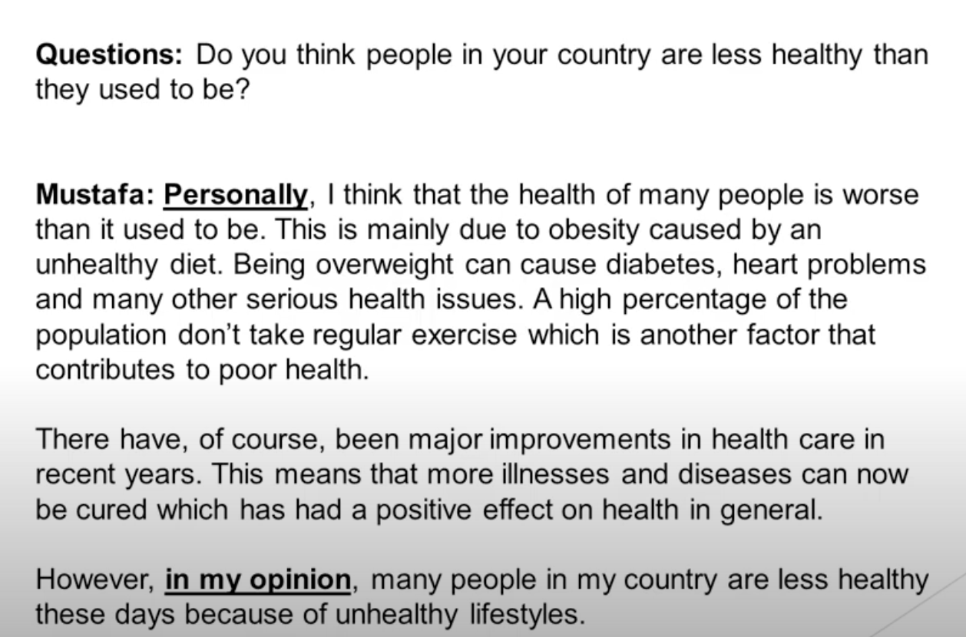
1- Opinion

Slide 40
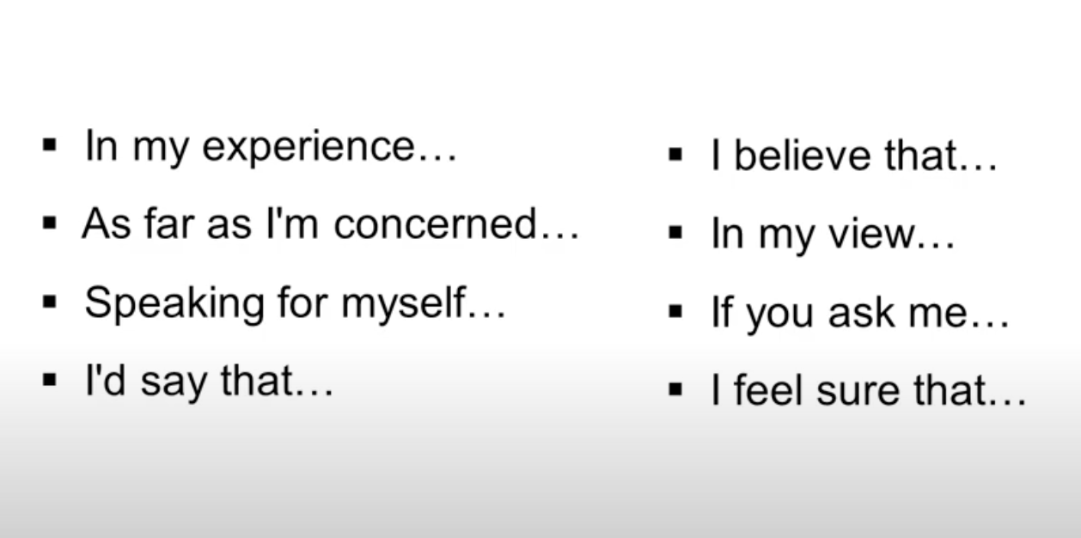
Opinion

Slide 41
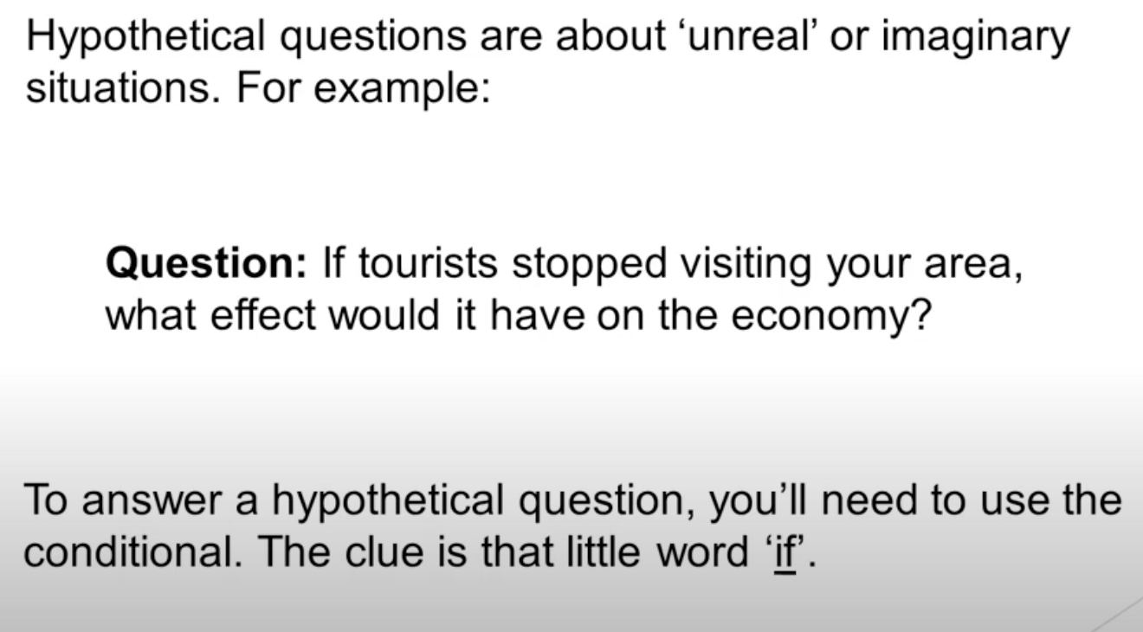
Hypothetical

Slide 42
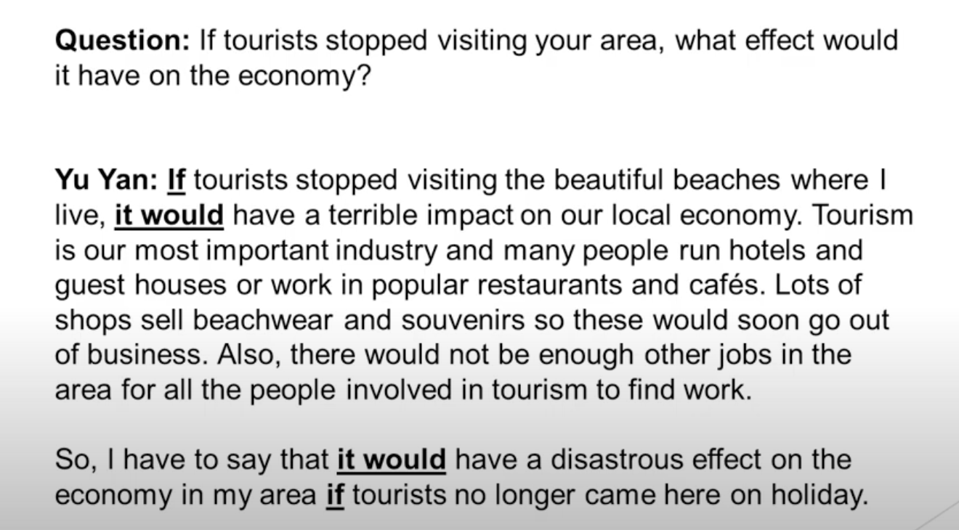
2- Hypothetical

Slide 43
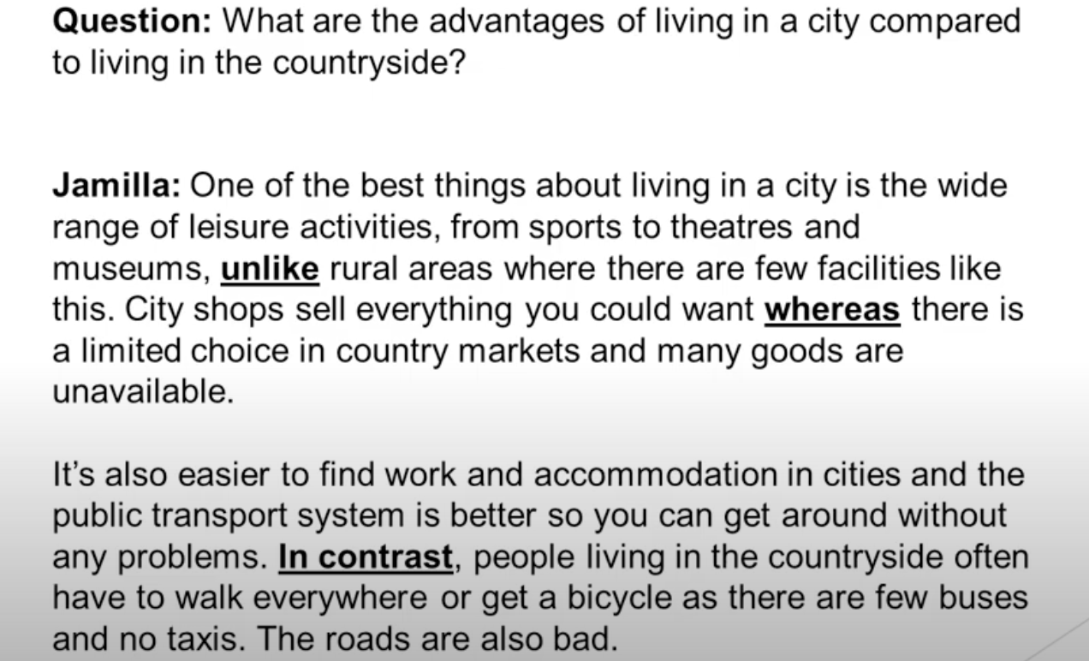
3- Compare & Contrast

Slide 44
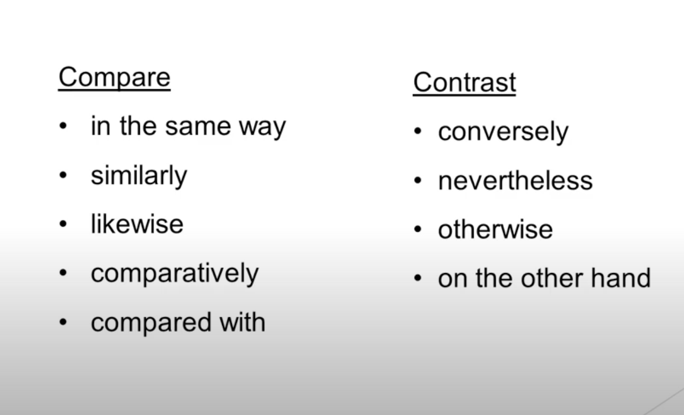
Compare & Contrast

Slide 45
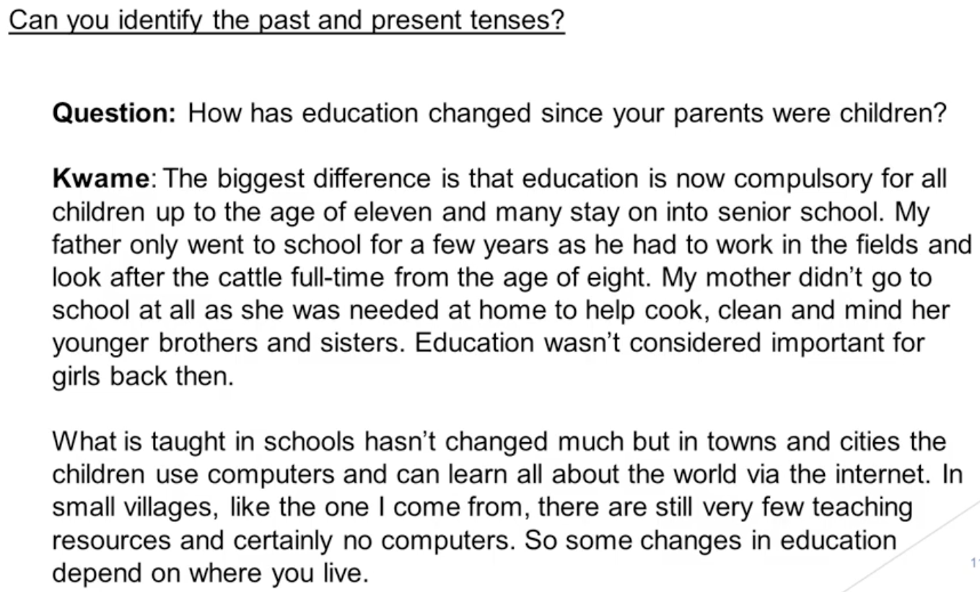
4- Change

Slide 46
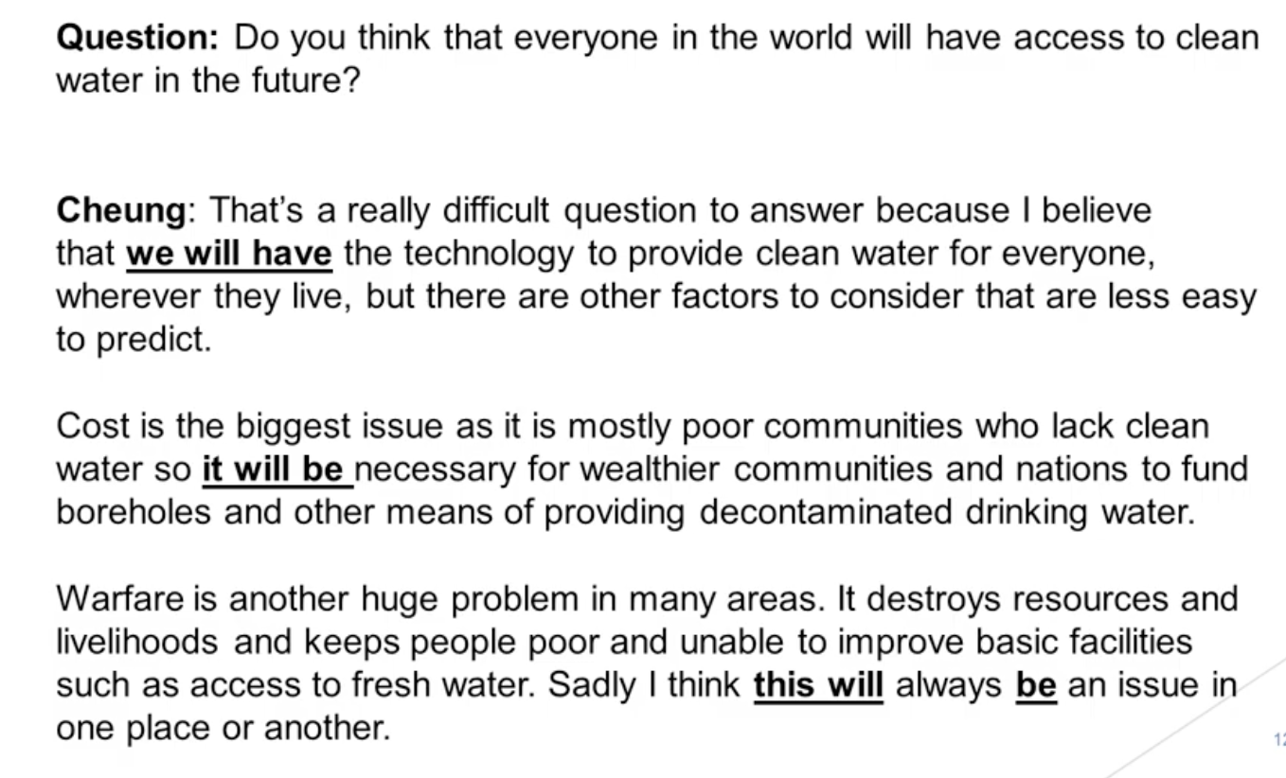
5-Future

Slide 47
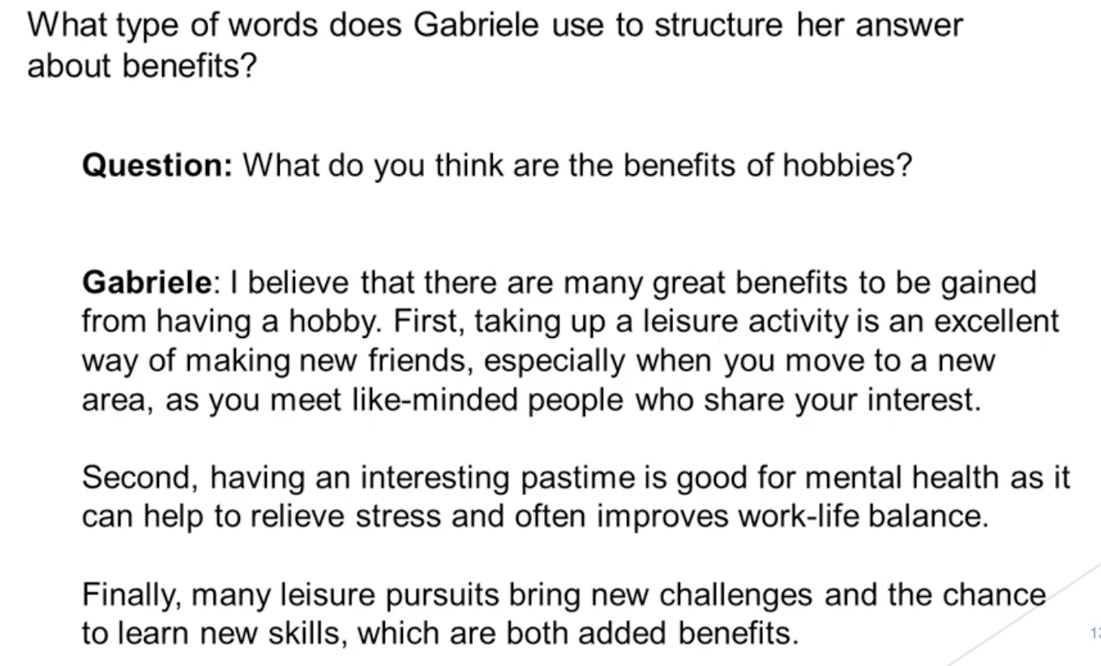
6- Benefits

Slide 48
THE END

